Slide 1


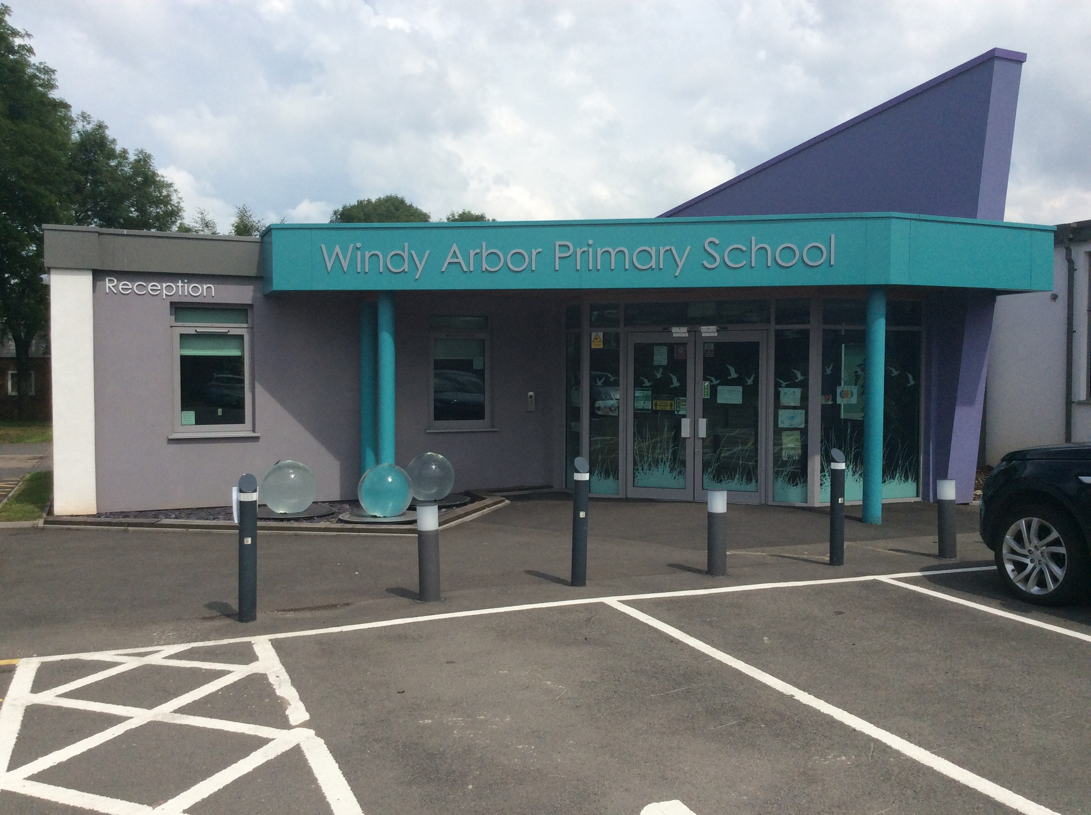

Welcome to
Year 6
Inspire Workshop

Slide 2

Our School Vision
"To equip and empower everyone so that they can make a positive contribution to society and be the best version of themselves."
We believe working in partnership with you, will achieve the very best outcomes for your children.

Slide 3





SMART Rules & Behaviour Expectations
Children are encouraged to care for each other, their belongings, and the learning environment, instilling responsibility and respect. When challenging behaviour occurs, staff address it directly, explaining consequences and guiding children towards positive choices.
At Windy Arbor, we embed our smart rules to:
- maintain levels of good behaviour.
- provide a consistent approach in rewarding good behaviour.
- provide a consistent approach in responding to unacceptable behaviour.
- ensure that behaviour does not prevent learning or affect a pupil's potential.

Slide 4
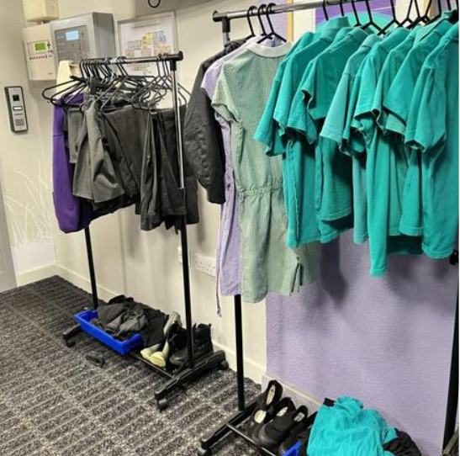
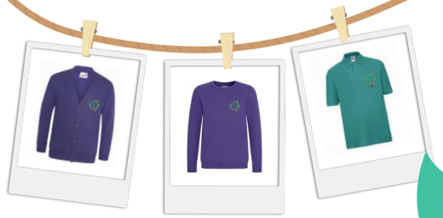


Uniform
All Children are expected to wear full school uniform, including our school P.E kit.
Turquoise polo shirt G
School Uniform
Second-hand Uniform
Purple cardigan/sweatshirt
Turquoise polo shirt
Grey skirt, pinafore, shorts, or trousers
Black shoes or ALL black trainers
A selection of second-hand uniform is available in the school foyer. If you need anything specific, please ask at the office.

Slide 5
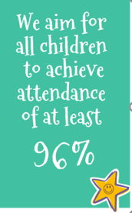
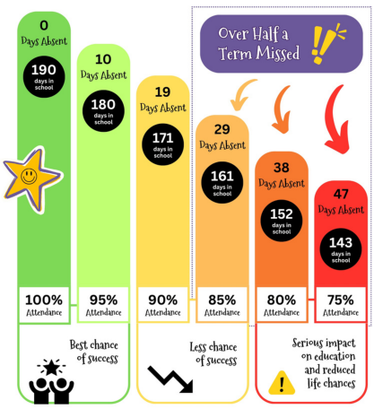
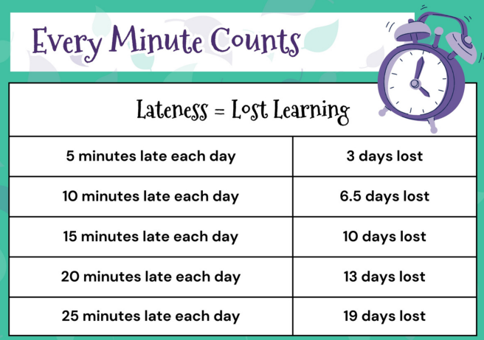
Attendance
At Windy Arbor, we expect all our children to have excellent
attendance and punctuality.

Slide 6
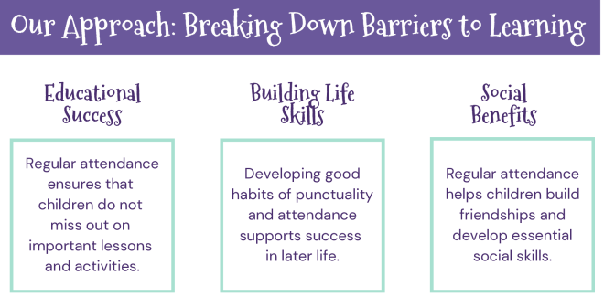





Attendance
We reward good attendance!
Daily Dojo
Certificates
Class Rewards
Book Vending Machine
Termly Attendance Event
Best chance of success

Slide 7
Attendance
Why do children need to go to school everyday?
Research found that pupils who performed better both at the end of primary and secondary school missed fewer days than those who didn’t perform as well.
The data also shows that in 2019, primary school children who didn’t achieve the expected standard in reading, writing and maths missed on average four more days per school year than those whose performance exceeded the expected standard.
Every moment in school counts, and days missed add up quickly. For example, a child who is absent for three days over a half term could miss 18 lessons in total.
Taken from: DFE – 18th May 2023.

Slide 8
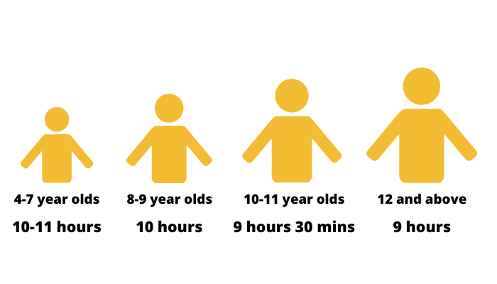
Lack of sleep can impact learning!
Children should get the proper amount of sleep at night to help stay focused, improve concentration, and improve academic performance.
In a survey of children across our school, from year 2 to year 6, when asked:
‘How do you feel when you come to school each day?’
65% of children told us they feel tired.
“Fed up that I have to wake up”
“I feel alright but I don’t get enough sleep”
“School is great but I feel tired”
“Tired but I’m happy to come”

Slide 9


Hunger can impact learning!
Please encourage your child to eat breakfast each day.
Breakfast is a really important meal, it is quite simply, food for your brain! It breaks the overnight fasting period and replenishes the supply of glucose to boost your energy levels and alertness.
We provide ‘Breakfast Club’ each morning. The charge for this is £1 per day. To request a place, please contact the school office.

Slide 10
Aims
To share our aims for your child as they continue their school journey at Windy Arbor.
To help you support your child for the next stage of their school life.
To inform you of the age-related expectations for year 6 pupils.
To have fun with your children in their learning environment

Slide 11
School Assessments
SATs in year 6 will take place week commencing Monday 11th May and will run until Thursday 14th May 2026.
Formative assessment – ongoing teacher assessment.
Summative assessment – assessment that takes place termly through set questions or tasks. (old SATs papers)

Slide 12

Expectation Booklets
At the end of last year, you received an email containing an ‘Expectation Booklet’ for your child’s year group.
This has all the information regarding your child’s learning, attendance expectations, uniform and homework expectations.
Please see a member of the Year 6 if you have not received one and would like one.

Slide 13
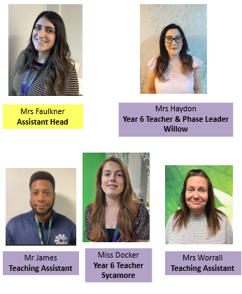
Year 6 Team

Slide 14
So far this term…
The children have settled in really well!
They are adapting well to new routines, new areas of study and being able to use different areas of the school.
They are enjoying the familiarity of the timetable and structures in place.
They are working really hard and showing us a great attitude towards their learning.

Slide 15

How can you help your child at home
Warning from your teacher
Removal from dojo
Loss of privileges
Isolation station
Time out in another classroom
Time out with phase leader
Behaviour contract
Suspension
Exclusion
Listen to your child read.
Read to your child.
Support children in their homework tasks.

Slide 16

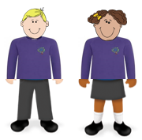
Steps to Success!
Complete homework
Read at home regularly
Have the right equipment
Positive attitude to learning
Wear correct uniform
Arrive ON TIME
Have breakfast
Get enough sleep
Dream Believe Achieve!

Slide 17
Working in Partnership
Daily, Practical Maths Sessions
Children will use concrete
There will be a range of opportunities for school and parents to work together!
Attend Parent Workshops
Read with your child every day
Attend Parent Meetings
Engage with Class Dojo
Support with homework
Visit our school website

Slide 18
Moving to the classrooms
Join staff and the Year 6 children in their classrooms for a glimpse into their learning day!

